Slide 1

Title Basic Hybrid Electric Vehicle (HEV) Power Flow Design
PRESENTED BY
Poonam
NIMS Institute of Engineering & Technology B.Tech Electrical Engineering Techn Global Internship Project
June 2026
Made with SlideMaker.app

Slide 2
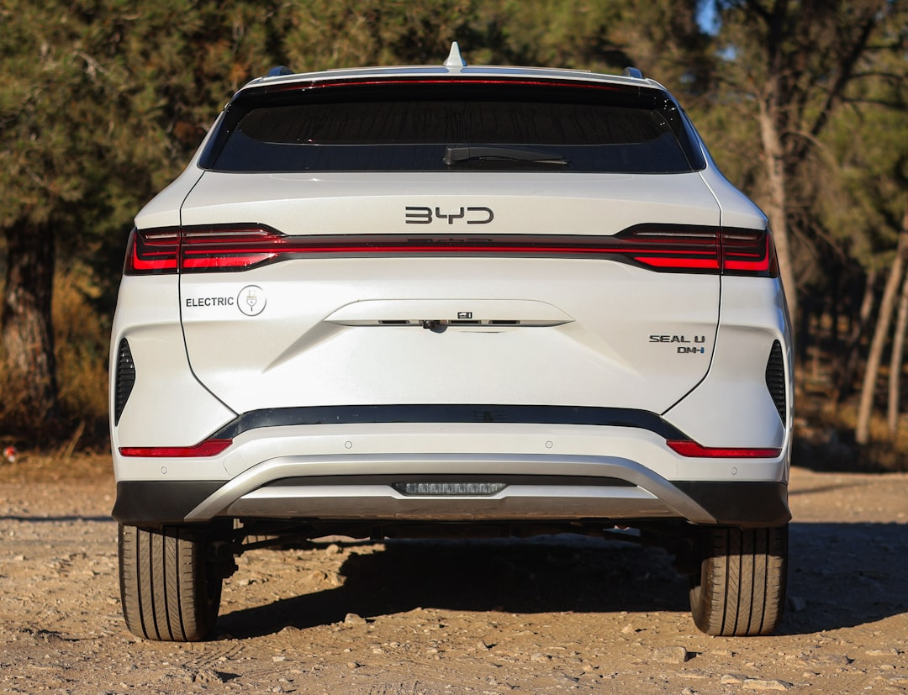
Hybrid Electric Vehicle (HEV) Power Flow Design Using MATLAB/Simulink
This project explores the design and simulation of a Hybrid Electric Vehicle (HEV) power flow system using MATLAB/Simulink. The focus is on optimizing the interaction between the internal combustion engine and electric motor to enhance efficiency and performance. By analyzing various configurations, we aim to demonstrate the potential of HEVs in reducing fuel consumption and emissions. This work is part of my Techn Global Internship Project at NIMS Institute of Engineering & Technology, scheduled for completion in June 2026.
Made with SlideMaker.app

Slide 3
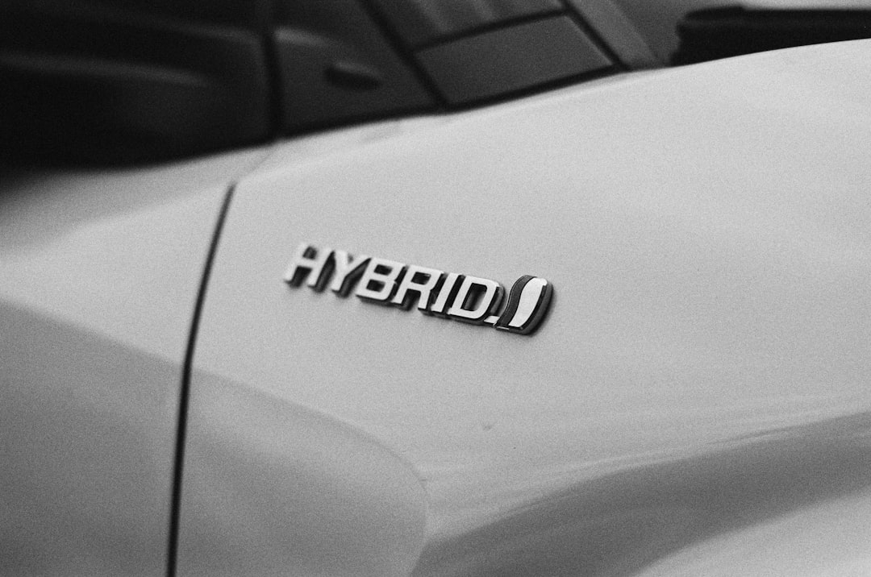
Define Hybrid Vehicle Configuration
Selected Configuration: Parallel HEV
Engine and Motor Synergy
The parallel HEV configuration allows both the internal combustion engine and electric motor to work simultaneously, enhancing overall vehicle efficiency and performance.
In this setup, the engine and motor collaborate to optimize power delivery, resulting in improved acceleration and responsiveness under various driving conditions.
Key Benefits of Parallel HEV
This configuration significantly reduces emissions and fuel consumption, making it an environmentally friendly choice while maintaining high performance and reliability.
Made with SlideMaker.app

Slide 4

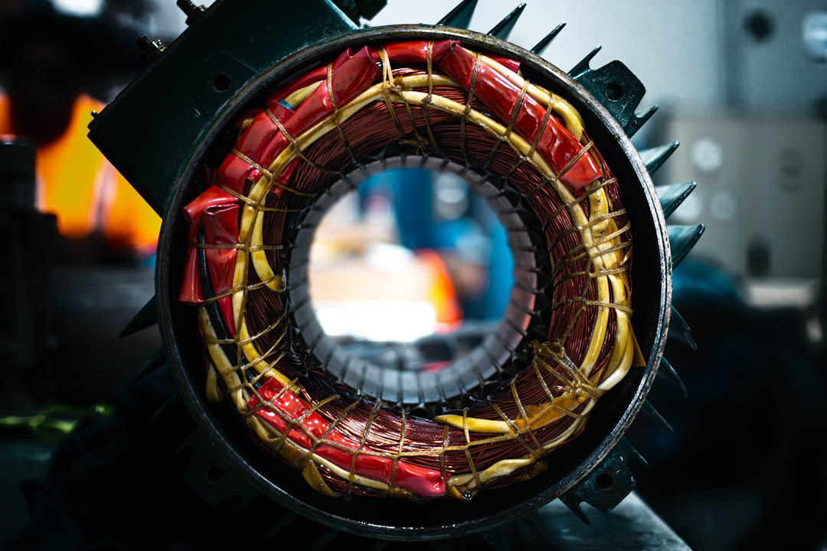
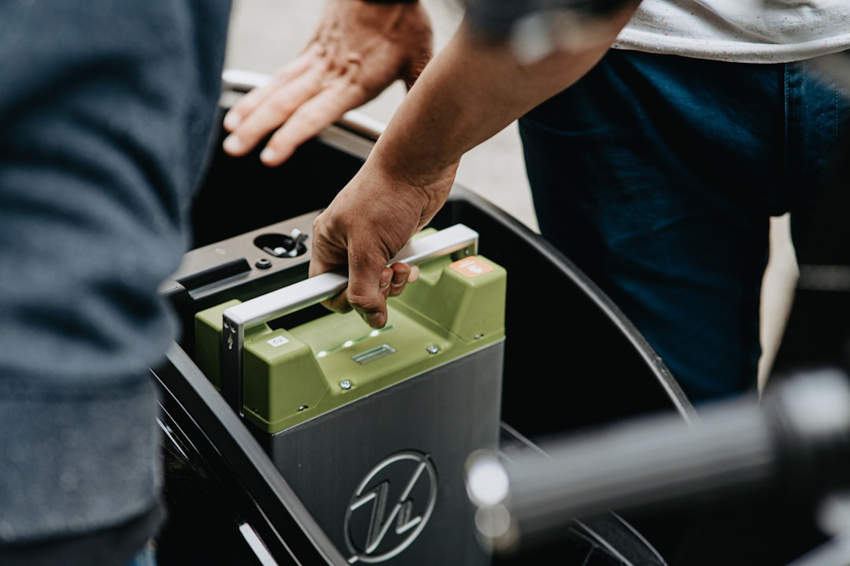
Identify Power Sources
Internal Combustion Engine (ICE)
Electric Motor
Battery Pack
The ICE serves as the primary power source, providing 60 kW of output, crucial for high-speed performance and long-range driving capabilities.
The electric motor contributes 80 kW, enhancing acceleration and enabling regenerative braking, which improves overall vehicle efficiency and reduces emissions.
With a capacity of 20 kWh, the battery pack stores energy for the electric motor, ensuring a reliable power supply and supporting hybrid operation.
Made with SlideMaker.app

Slide 5
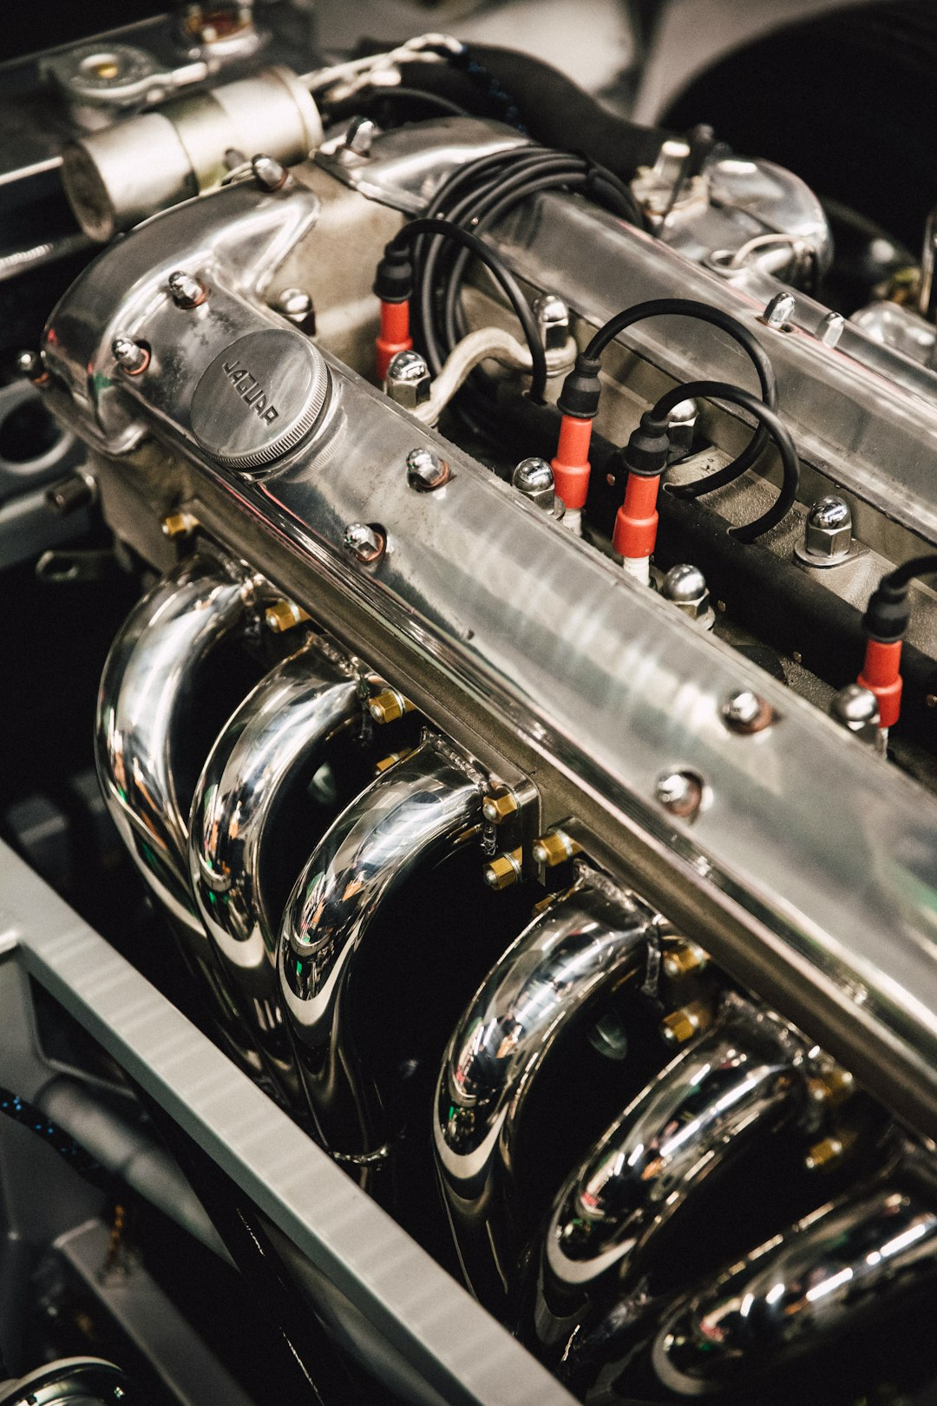
Collect Component Specifications
Engine Power Specification
Motor Power Specification
The internal combustion engine delivers 60 kW, ensuring optimal performance and responsiveness during various driving conditions, enhancing overall vehicle dynamics.
With a power output of 80 kW, the electric motor significantly enhances acceleration, providing instant torque and improving the vehicle's responsiveness and driving experience.
Battery Capacity Specification
The battery pack has a capacity of 20 kWh, allowing for extended driving range and supporting efficient energy management in hybrid operations.
Made with SlideMaker.app

Slide 6

System Block Diagram of HEV
This diagram illustrates the power flow architecture of the Hybrid Electric Vehicle. It shows how the engine and motor combine their outputs through a power combiner, optimizing efficiency and performance.
Made with SlideMaker.app

Slide 7

Calculate Energy Flow
1
Engine Output Contribution
The internal combustion engine (ICE) provides a steady output of 60 kW, crucial for maintaining vehicle performance during various driving conditions.
2
Motor Output Addition
The electric motor contributes an additional 80 kW, enhancing acceleration and overall efficiency, especially during low-speed operations and start-stop scenarios.
3
Total Power Output
Combining both sources, the total output reaches 140 kW, ensuring optimal energy flow for effective vehicle operation and improved fuel economy.
Made with SlideMaker.app

Slide 8

Model Torque and Speed Distribution
Power Sharing Dynamics
Balanced Operation
The model effectively simulates power sharing between the engine and motor, ensuring optimal torque distribution for enhanced vehicle performance under varying conditions.
A balanced vehicle operation is achieved through precise torque management, leading to improved acceleration and stability during different driving scenarios.
Performance Metrics
Performance metrics indicate significant improvements in responsiveness and fuel efficiency, showcasing the advantages of hybrid configurations in real-world applications.
Made with SlideMaker.app

Slide 9
Simulate Power Split and Fuel Consumption
1
2
3
Simulink Simulation Overview
Parallel Power Distribution
Fuel Consumption Analysis
A comprehensive Simulink simulation was conducted to analyze power distribution between the engine and motor, ensuring optimal performance under various driving conditions.
The parallel configuration allows simultaneous power delivery from both sources, enhancing overall system efficiency and reducing energy losses during operation.
Efficient energy utilization from the hybrid system leads to a significant reduction in fuel consumption, validating the theoretical models and assumptions made during the design phase.
Made with SlideMaker.app

Slide 10
Analyze Efficiency Under Different Loads
•
Motor Efficiency Considered
Motor efficiency was maintained at 90% during the analysis, ensuring accurate performance metrics across various load conditions for the hybrid vehicle.
•
Performance Evaluation
The performance of the HEV was evaluated under different operating conditions, revealing how load variations impact overall efficiency and fuel consumption.
•
Fuel Economy Optimization
Through optimization techniques, better fuel economy was achieved, demonstrating the importance of efficient power distribution in hybrid electric vehicles.
•
Load Impact Insights
Insights gained from the analysis highlight how varying loads affect the overall efficiency, guiding future improvements in hybrid vehicle design.
Made with SlideMaker.app

Slide 11
Conclusion
The HEV power flow model effectively illustrates the synergy between the internal combustion engine and electric motor, achieving a total output of 140 kW. This simulation not only enhances understanding of hybrid vehicle dynamics but also highlights the potential for improved fuel efficiency. Future work should focus on real-world applications and further optimization of energy management strategies to maximize performance and sustainability in hybrid vehicles.
Made with SlideMaker.app

